Slide 1
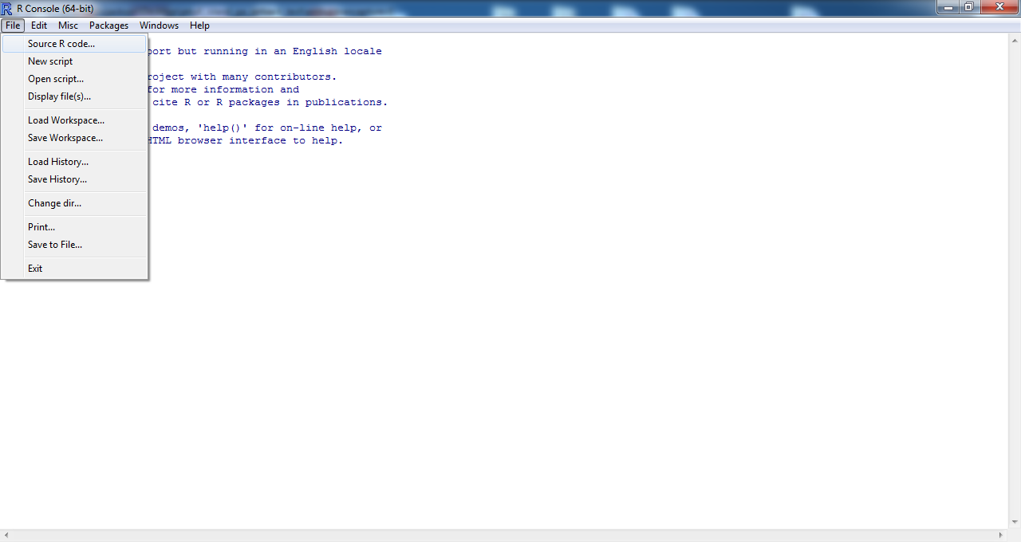
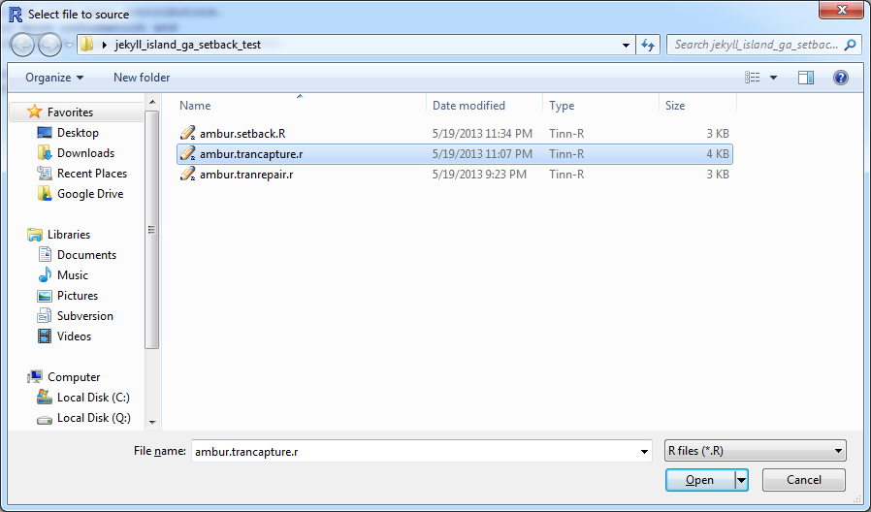
Getting AMBUR code/scripts in to R for testing…
To get the source code in to R:
Go to File -> Source R code and select the ambur R file with code
Or:
- Open the code in a text editor like WordPad and copy and paste directly into R at the console prompt.

Slide 2
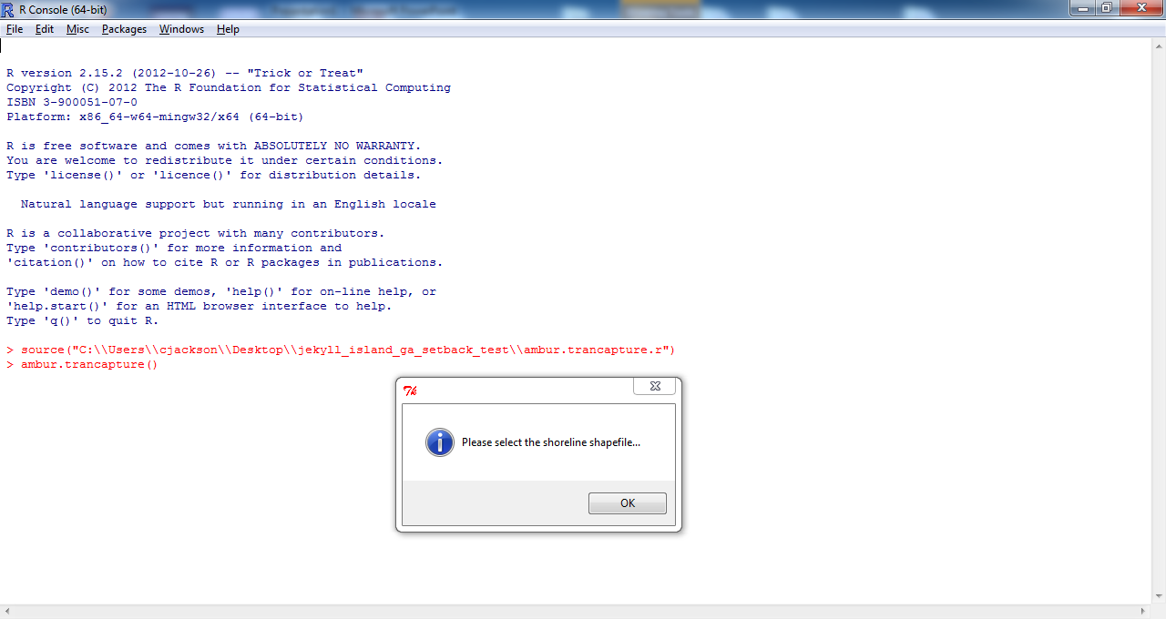
Creating Setbacks Lines/Points Using custom AMBUR functions for NCDCM
To capture data from a vegetation line or other boundary using transects:
Load Source R code: ambur.trancapture
Type the following at R console prompt:
ambur.trancapture()
-Follow the instruction prompts
-The 'select shoreline’ prompt is where a vegetation or other boundary polyline shapefile is selected.
The ‘select transects’ prompt is where the “original_transects.shp” shapefile is chosen. This shapefile is generated by the ambur.statshape function or building shapefiles after analyzing capture points in the ambur GUI.
An new shapefile is generated in a new folder called AMBUR_capture.
NOTE: Vegetation lines or other boundary types do not need any special fields in the attribute table to be used with this R function. This R function is different than the stock ambur.capture function.

Slide 3
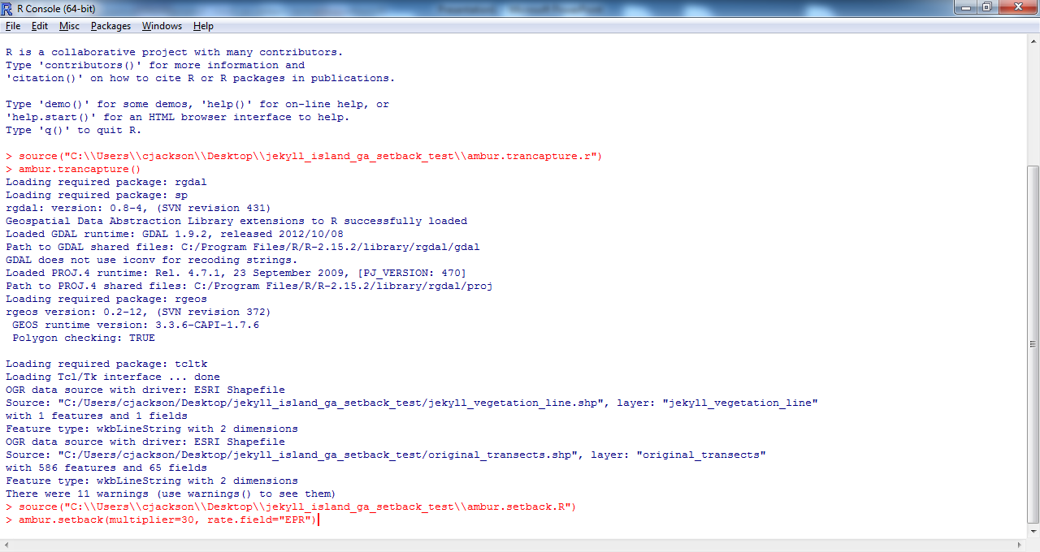
Creating Setbacks Lines/Points Using custom AMBUR functions for NCDCM
To generate setback lines and points:
Load Source R code: ambur.setback
Type the following at R console prompt:
ambur.setback(multiplier=30, rate.field="EPR")
*multiplier is the number of years or a raw number to multiply with shoreline change rates
*rate.field is the name of the field in the shapefile’s table (in quotes) containing shoreline change rates. You may enter a number here (not in quotes) if you want a single rate applied all transects. (negative is erosion/ positive is accretion)
-Follow the instruction prompts after entering the command and select the ambur.trancapture (transect_captured_pts.shp) generated points shapefile
-New points and polyline shapefiles will are generated with setback positions in the folder with the transect_captured_pts.shp

